Slide 1
Unsupervised Neural Networks
Feb 2024

Slide 2
Introduction
Artificial neural networks with unsupervised learning have been applied with success to problems of pattern recognition and signal detection. these networks construct classes or categories from the input data using correlations or similarity measures and try to identify “optimal” partitions in the set of input data.

Slide 3

Introduction
In a competitive neural network, output units compete with each other to fire; only the one with the highest synaptic potential is activated. The idea of competitive learning is already outlined in the early work of von der Malsburg (1973) on the self-organization of nerve cells in the cerebral cortex. In 1975, Fukushima proposed the cognitron, which is a self-organizing multilayer competitive network. Willshaw and von der Malsburg (1976) worked on the formation of neural connections by self-organization and Grossberg (1972, 1976) on adaptive pattern classification.

Slide 4
Competitive Learning Rule
Rumelhart and Zisper (1985) specified the three basic elements of a competitive learning rule:
A set of neurons (process units) that are activated or not in response to a set of input patterns (stimuli) and that differ in the values of a set of synaptic weights specific to each neuron.
A limit imposed on the "strength" of each neuron.
A mechanism that allows neurons to compete to respond to a subset of inputs in such a way that one and only one neuron per group fires.

Slide 5
Competitive Learning
Competitive learning can be implemented using a two-layer (J–K) neural network. The input and output layers are fully connected. The output layer is called the competition layer, wherein lateral connections are used to perform lateral inhibition.

Slide 6
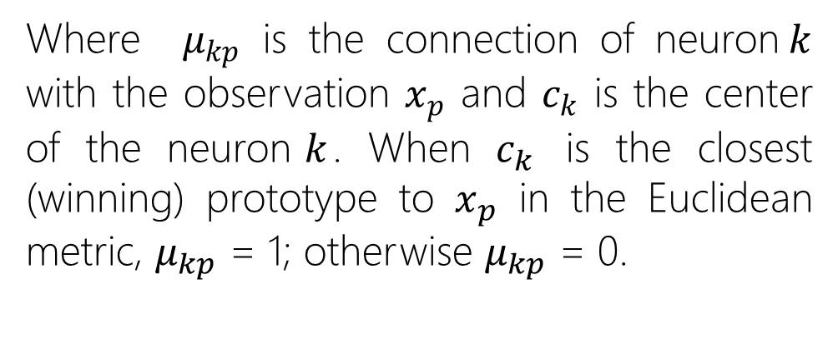
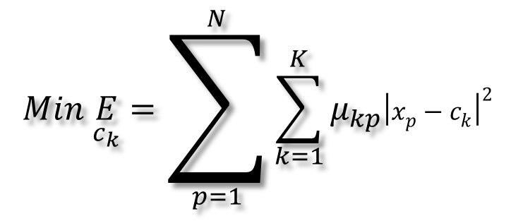
Competitive Learning
Competitive learning is usually derived by minimizing the mean squared error (MSE) functional (Tsypkin, 1973)
$$Min \underset{c_{k}}{E}=\sum_{p=1}^{N}{\sum_{k=1}^{K}{μ_{kp}{\left|x_{p}−c_{k}\right|}^{2} }}$$
Where $μ_{kp}$ is the connection of neuron$k$ with the observation $x_{p}$ and $c_{k}$ is the center of the neuron$k$. When $c_{k}$ is the closest (winning) prototype to $x_{p}$ in the Euclidean metric, $μ_{kp}$ = 1; otherwise $μ_{kp}$ = 0.

Slide 7
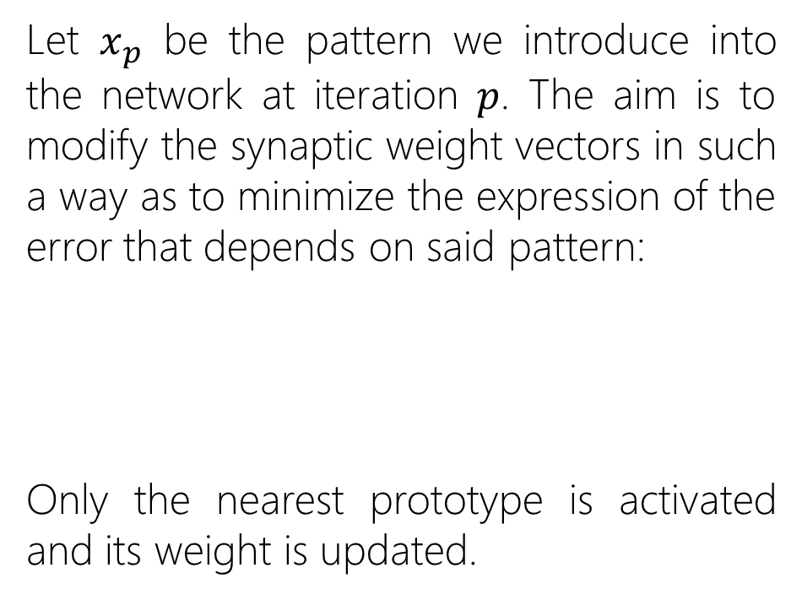
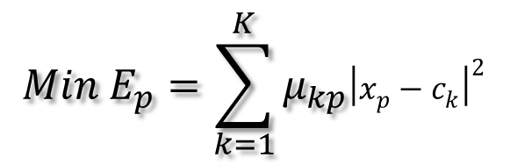
Competitive Learning
Let $x_{p}$ be the pattern we introduce into the network at iteration $p$. The aim is to modify the synaptic weight vectors in such a way as to minimize the expression of the error that depends on said pattern:
Only the nearest prototype is activated and its weight is updated.
$$Min E_{p}=\sum_{k=1}^{K}{μ_{kp}{\left|x_{p}−c_{k}\right|}^{2} }$$

Slide 8
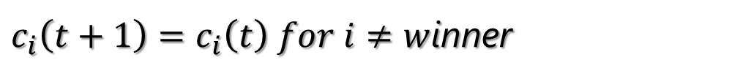
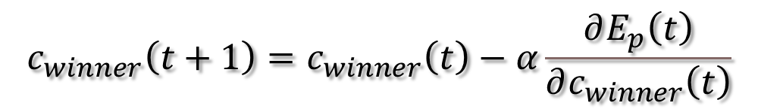
Competitive Learning
The weight of the winning neuron is updated according to the following learning rule:
$$c_{winner}\left(t+1\right)=c_{winner}\left(t\right)−α\frac{∂E_{p}\left(t\right)}{∂c_{winner}\left(t\right)}$$
$c_{i}\left(t+1\right)=c_{i}\left(t\right) for i≠w$inner

Slide 9

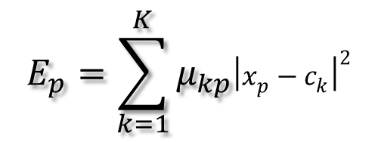
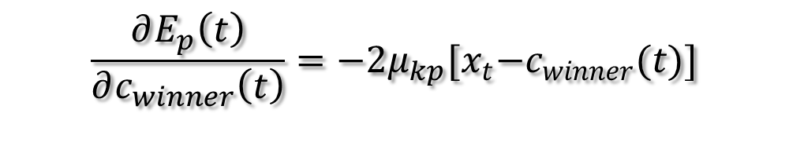

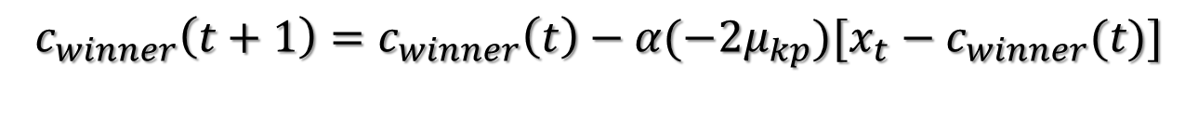
Competitive Learning
Calculating the partial derivative:
$$E_{p}=\sum_{k=1}^{K}{μ_{kp}{\left|x_{p}−c_{k}\right|}^{2} }$$
$$\frac{∂E_{p}\left(t\right)}{∂c_{winner}\left(t\right)}=−2μ_{kp}{[x}_{t}−c_{winner}(t)]$$
$$c_{winner}\left(t+1\right)=c_{winner}\left(t\right)−α\frac{∂E_{p}\left(t\right)}{∂c_{winner}\left(t\right)}$$
$$c_{winner}\left(t+1\right)=c_{winner}\left(t\right)−α(−2μ_{kp}{)[x}_{t}−c_{winner}(t)]$$
$η\left(t\right)=$ $−α(−2μ_{kp})$
$$c_{winner}(t+1)=c_{winner}(t)+η(t)[x_{t}−c_{winner}(t)]$$

Slide 10
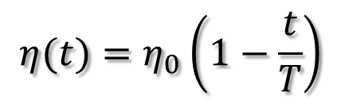
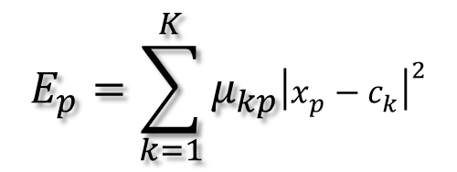
Competitive Learning
Calculating the partial derivative:
$$E_{p}=\sum_{k=1}^{K}{μ_{kp}{\left|x_{p}−c_{k}\right|}^{2} }$$
$$c_{winner}(t+1)=c_{winner}(t)+η(t)[x_{t}−c_{winner}(t)]$$
$$η(t)=η_{0}\left(1−\frac{t}{T}\right)$$
$c_{i}\left(t+1\right)=c_{i}\left(t\right) for i$≠winner

Slide 11

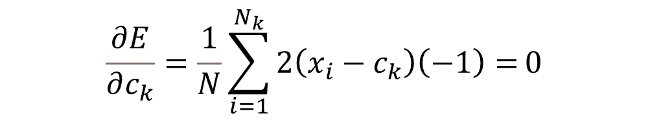
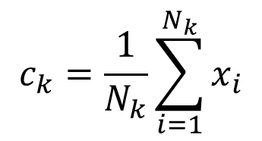
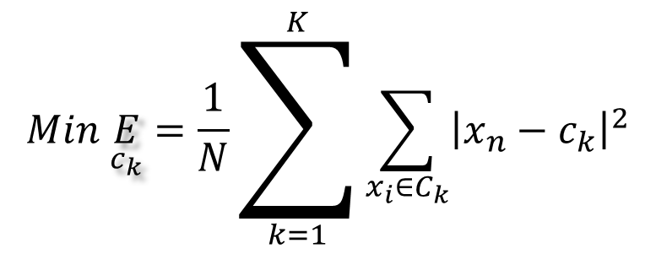
Competitive Learning
Si suponemos la siguiente especificación:
$$Min \underset{c_{k}}{E}=\frac{1}{N}\sum_{k=1}^{K}{\sum_{x_{i}∈C_{k}}{{\left|x_{n}−c_{k}\right|}^{2}}}$$
$$\frac{∂E}{∂c_{k}}=\frac{1}{N}\sum_{i=1}^{N_{k}}{2\left(x_{i}−c_{k}\right)\left(−1\right)=}0$$
$$\frac{∂E}{∂c_{k}}=\frac{−2}{N}\sum_{i=1}^{N_{k}}{\left(x_{i}−c_{k}\right)=}0$$
$$c_{k}=\frac{1}{N_{k}}\sum_{i=1}^{N_{k}}{x_{i}}$$

Slide 12
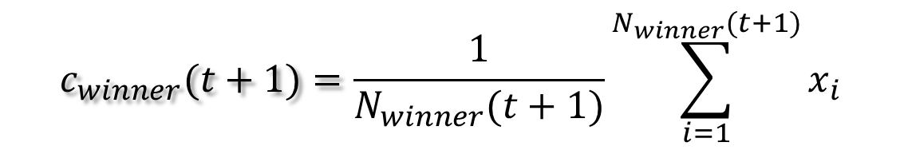
K-MEANS
Si suponemos la siguiente especificación:
$$Min \underset{c_{k}}{E}=\frac{1}{N}\sum_{k=1}^{K}{\sum_{x_{i}∈C_{k}}{{\left|x_{n}−c_{k}\right|}^{2}}}$$
$$c_{winner}(t+1)=\frac{1}{N_{winner}(t+1)}\sum_{i=1}^{N_{winner}(t+1)}{x_{i}}$$
$c_{i}\left(t+1\right)=c_{i}\left(t\right) for i$≠winner

Slide 13
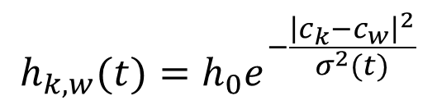
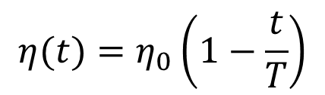
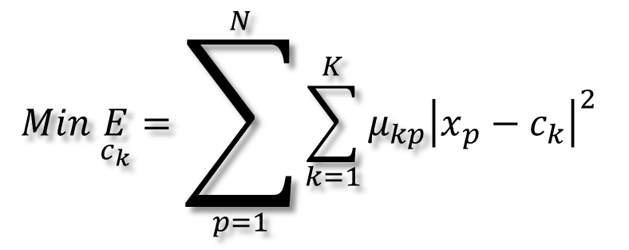
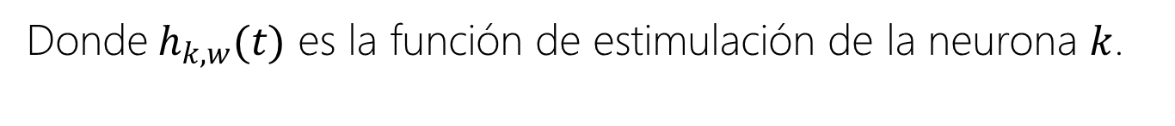
The Self Organizing Map
Las neuronas se actualizan siguiendo la regla de Kohonen rule,
$$Min \underset{c_{k}}{E}=\sum_{p=1}^{N}{\sum_{k=1}^{K}{μ_{kp}{\left|x_{p}−c_{k}\right|}^{2} }}$$
$$c_{k}(t+1)=c_{k}(t)+η(t)h_{k,w}(t)[x_{t}−c_{k}(t)]$$
$$η(t)=η_{0}\left(1−\frac{t}{T}\right)$$
$$h_{k,w}(t)=h_{0}e^{−\frac{{\left|c_{k}−c_{w}\right|}^{2}}{σ^{2}(t)}}$$
Donde${ h}_{k,w}(t)$ es la función de estimulación de la neurona $k$.

Slide 14
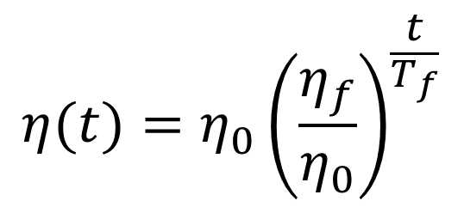
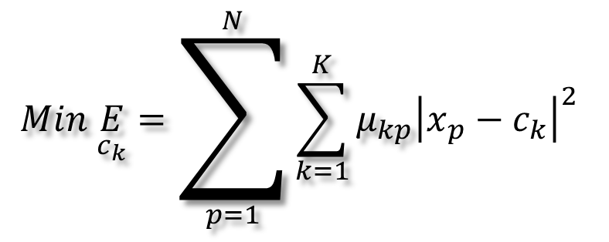
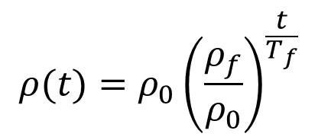
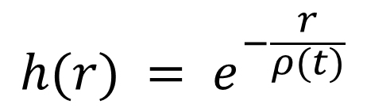

The Neural Gas
Desarrolla el siguiente algoritmo de aprendizaje,
$$Min \underset{c_{k}}{E}=\sum_{p=1}^{N}{\sum_{k=1}^{K}{μ_{kp}{\left|x_{p}−c_{k}\right|}^{2} }}$$
$$c_{k}(t+1)=c_{k}(t)+η(t)h[r_{k}(t)][x_{t}−c_{k}(t)]$$
$$h(r) = e^{−\frac{r}{ρ(t)}}$$
Where,
$$r_{k}(t): t→\{0,1,...,K−1\}$$
$$η(t)=η_{0}{\left(\frac{η_{f}}{η_{0}}\right)}^{\frac{t}{T_{f}}}$$
$$ρ(t)=ρ_{0}{\left(\frac{ρ_{f}}{ρ_{0}}\right)}^{\frac{t}{T_{f}}}$$

Slide 15
Questions?

